Slide 1
Automation Training
QPE QA

Slide 2
Main Topics
Configuration + Setup
Capital, Electrical, VeSys, CapH
RegTest Execution
RegTest Creation
Generate Report

Slide 3
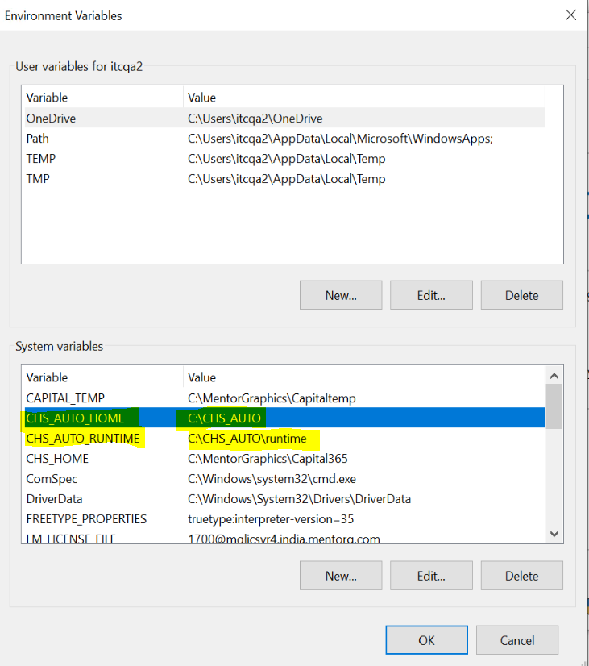
Configuration + setup
Capital side
Set Capital Env Variables
1 tier
2 tier
3 tier
Automation side
Extract auto zip
Set Automation Env
Variables
Setup.ini
Runtime folder

Slide 4
RegTest Execution
Execute one sample test
Check the results
C:\CHS_AUTO\bin>perl run.pl -help
Usage: run.pl [Playback Options] <Test Selection Option>
Playback tool for functional tests
Playback Options:
-D <name>=<value> : Set a system property
-help : Print this message
-noEnvSetup: : Don't do any environment setup. If not specified this script will set various environment variables needed for some (but not all) tests.
-noStop: : Don't stop applications. Playback ends at first failure with clients applications running.
-noStopServices : Only stop server applications when required by rollback
-noSkip : Run tests even if they are skipped with the SKIP command
-repeat <n> : Repeat a single run, n times, renaming the result directory per iteration.
Only applicable when using -f for a single RegProc or RegTest with no procs.
Test Selection Option:
-a <directory path> : Run all tests below the specified directory, path relative to $CHS_AUTO_HOME/tests
-d : Run all tests specified by the TEST_DIRECTORIES setup parameter
-f <test path> : Run a single test, path relative to $CHS_AUTO_HOME/tests
-l <filelist path> : Run all tests listed in the specified filelist, path relative to $CHS_AUTO_HOME/setup
-t <filelist path> : Identify and run all RegTests for tests listed in the specified filelist, path relative to $CHS_AUTO_HOME/setup"
-setup : Run tests according to options in $CHS_AUTO_HOME/setup/setup.ini
Additional Option:
-copyJarsToAppHome : Optionally, copy few jars (junit, javafx,..) to $CHS_HOME/lib

Slide 5
RegTest Creation
How to create RegTests
Tips
Delivery methods
Best practice
http://ies-iesd-conf.ies.mentorg.com:8090/display/DI/Automation+Tests+Best+Practice

Slide 6
Generate Report
How to generate automation report after execution
User perl script / batch script
Methods
Other scripts information
C:\CHS_AUTO\bin>perl summary.pl -help
Usage summary.pl [Options]
Generate a summary of automation results
Options:
-build <ID> : Specify the build ID. Default is the latest build
-categoryDepth <category:n> : Generate the top-level summary with n sub-categories for the specified category
-display : Display the summary after generation
-[no]generateRegTestResults : Generate RegTest results if RegProc results are found with no corresponding RegTest. Default OFF.
-help : Print this message
-mail <inifile> : Email the summary using settings in infile. Default $CHS_AUTO_HOME/setup/setup.ini
-level <Level> : Specifies the level of summary generation. Allow DEFAULT/QUICK/DETAILED
-noCopyLatest : Do not copy the latest summary.html and text files to the stream directory
-onlyDisplay : Display an existing summary without regeneration
-refBuild <ID> : Compare against a particular build in the reference stream
-refRuntime <dir> : Compare against a reference runtime directory
-refStream <stream> : Compare against a reference stream
-repeat : Repeatedly regenerate the summary according to SUMMARY_REPEAT_... settings in $CHS_AUTO_HOME/setup/setup.ini
-runtime <dir> : Specify the runtime directory. Default $CHS_AUTO_RUNTIME if set or $CHS_AUTO_HOME/runtime
-showAvailable : Include a count of all available RegTests found below $CHS_AUTO_HOME/tests
-stream <stream> : Specify the stream. Taken by default from $CHS_AUTO_HOME/setup/setup.ini
-summaryNote <note> : Additional information for inclusion in the header section of generated HTML summary pages
-summaryRoot <dir> : Specify the directory into which summaries are written. Default runtime/stream/build/summary
-testList <file> : Generate the summary based only on the tests listed in the file
-zipSummary : Zip the failures & regressions summary and text files into failures.zip in summary folder

Slide 7
Generate Report
Example:
%CHS_AUTO%/bin> perl summary.pl –stream <<Stream name>>
In our case stream name is “Local”
%CHS_AUTO%/bin> perl summary.pl –stream Local
THE END

